Slide 1



GEBZE TECHNICAL UNIVERSITY
THEORY OF COMPUTATION COURSE
HALTING PROBLEM
Presented by
Muhammed Akif SEVİLGEN
Çağrı ÇAYCI

Slide 2
INTRODUCTION
The Halting Problem is a fundamental concept in computability theory, first proved by Alan Turing in 1936. Turing introduced the concept of a theoretical computing device known as the Turing Machine, which can compute anything that is computable. Turing demonstarated that no general algorithm exists that can determine whether any given program, run on a Turing Machine, will halt (stop running) or continue to run forever for a particular input, even with limitless memory and time.
Understanding whether a program will halt or run forever is crucial for managing resources, debugging, optimizing performance, ensuring safety and reliability, and enhancing user experience.

Slide 3
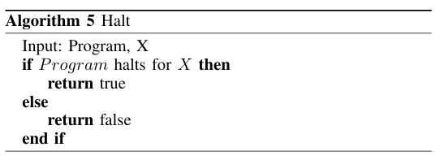
INFORMAL DEFINITION
The purpose of the Halting Problem is to inquire about the existence of an algorithm capable of determining whether a given program, when provided with a specific input (X), will terminate or continue running indefinitely. This algorithm would ideally return true if the program halts for the input and false if it doesn't.

Slide 4
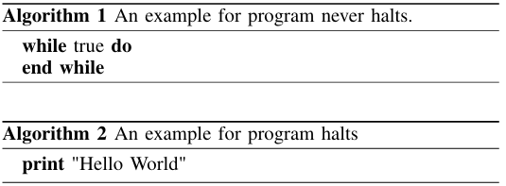
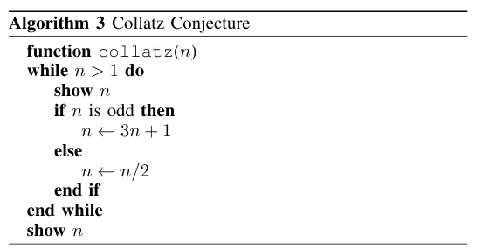
INFORMAL DEFINITION
For simpler programs, determining their behavior is straightforward, as seen in Algorithm 1 and Algorithm 2. However, as algorithms become more complex, the decision-making process also becomes more intricate, as illustrated in Algorithm 3.

Slide 5
FORMAL DEFINITION
The Halting Problem is formally defined as the set of all pairs ⟨M, w⟩, where M represents a Turing machine and w is an input to that machine, such that M halts on input w. This can be expressed as:
HALT = {⟨M, w⟩ | M is a Turing machine and halts on input w}
The essence of the Halting Problem lies in asserting the nonexistence of a universal algorithm capable of determining membership in this language HALT, for all possible M,w pairs.

Slide 6
PROOF BY REDUCTION
Acceptance problem involves determining whether there exists an alogrithm that, given a Turing Machine M and an input w, can decide whether M will halt and accept w. It can be expressed as follows;
ATM= {⟨M, w⟩ | M is a Turing machine and accepts input w}
However, it has been proven that the acceptance problem is undecidable, meaning no such algorithm can exists to accomplish this task. To prove HALT is undecidable, ATM will be reduced to HALT.

Slide 7
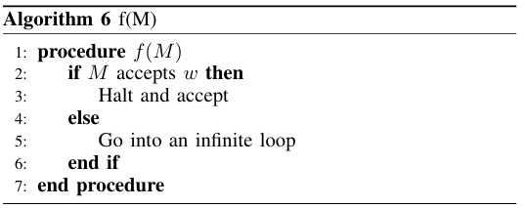
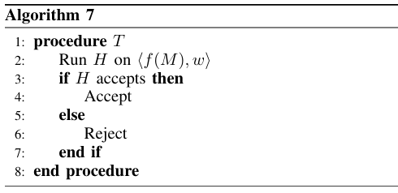
PROOF BY REDUCTION
  Assume that Halting problem is decidable, means there is TM H, that decides whether a TM halts or runs forever for an input.
  Consider a new machine f(M) which gets M and w as input;
    Accept if M accept w.
    Otherwise, reject.
  Consider a new machine T.
    If H accepts <f(M), w>, it means f(M) halts on input w. Therefore, M accepts w.
    If H rejects <f(M), w>, it means f(M) does not halt on input w. Therefore M does not accept w.
A hypothetical decider is created for Acceptance Problem, However, Acceptance Problem is undecidable, which is a contradiction.

Slide 8
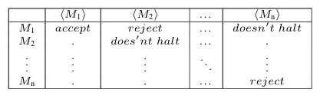
PROOF BY DIAGONALIZATION
Let's create a table consisting of an infinite number of Turing Machines and an infinite set of inputs, where each row represents a Turing Machine, and each column represents a set of inputs. The cells in this table indicate whether the corresponding Turing Machine accepts, rejects, or does not halt for the corresponding input.

Slide 9
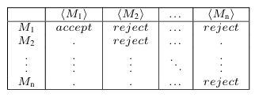
PROOF BY DIAGONALIZATION
Let's assume there is a Turing Machine, named H, that can determine for all possible inputs whether a given Turing Machine M will accept an input w. We can represent this in a table that shows the behavior of H as follows:

Slide 10

PROOF BY DIAGONALIZATION
Assuming the existence of a Turing Machine H, we can also assume the existence of another Turing Machine D. Machine D takes the description of a Turing Machine as input and returns the reverse of the entry in the table of H.
Consider a scenario where the first table contains all Turing Machines (TMs). One of these TMs, denoted as Mx, must be equal to D. Along the diagonal of Table I, Mx can be in one of three states: accept, reject, or not halt. If Mx accepts in Table I, it would consequently accepts in Table II. However, due to the reverse logic applied, it should then reject in Table III. Conversely, if Mx either rejects or does not halt in Table I, it would reject in Table II. Consequently, it would accept in Table III. This leads to a contradiction because Mx cannot consistently behave in a manner that aligns with the expected outcomes across all tables. Therefore, Mx cannot be equal to D, resulting in a contradiction.

Slide 11
TURING’S PROOF
Turing’s proof of the undecidability of the halting problem begins by assuming the existence of a hypothetical halting algorithm H(P,x) that determines whether a program P halts on input x. Turing then constructs a new program D that uses H to determine its own behavior. The program D operates as follows:
D(P) calls H(P,P):
If H(P,P) returns true (P halts on P), then D(P) goes into an infinite loop.
If H(P,P) returns false (P does not halt on P), then D(P) halts.
Now consider what happens when D is given itself as input:
If H(D,D) returns true, then D(D) should loop forever (contradiction).
If H(D,D) returns false, then D(D) should halt (contradiction).

Slide 12
TURING’S PROOF (CONDT.)
D(P) calls H(P,P):
If H(P,P) returns true (P halts on P), then D(P) goes into an infinite loop.
If H(P,P) returns false (P does not halt on P), then D(P) halts.
Now consider what happens when D is given itself as input:
If H(D,D) returns true, then D(D) should loop forever (contradiction).
If H(D,D) returns false, then D(D) should halt (contradiction).
Both cases lead to a contradiction, as the existence of H would mean that D both halts and does not halt when given its own description. This proof shows that the halting problem is undecidable. Therefore, there is no algorithm that can solve the halting problem for all possible program-input pairs.

Slide 13
ANOTHER PROOF: PROOF BY CONTRADICTION
Christopher Strachey outlined a proof by contradiction that the halting problem is not solvable.
Assumption: Suppose that there exists a computable function halts(f) that returns true if the subroutine f halts and returns false otherwise.
def g():
if(halts(g)):
loop_forever()
  halts(g) must either return true or false
  If halts(g) returns true, then g will call loop forever() and never halt (contradiction)
  If halts(g) returns false, then g will halt (contradiction)
As a result, g does the opposite of what halts says g should do. Therefore, the initial assumption that halts is a total computable function must be false.

Slide 14
IMPACTS OF THE HALTING PROBLEM
THEOROTICAL IMPACTS
  Limits of Computation: It points out the fact that some problems cannot be solved by algorithms and sets basic limits on what can be computed.
  Rice’s Theorem: Rice’s theorem, which asserts that it is impossible to determine any non-trivial aspect of program behavior, builds on the halting problem
  Gödel’s Incompleteness Theorem: The halting problem is related to Gödel’s work, shows that there exist true statements that are not provable within any sufficiently strong formal system.

Slide 15
IMPACTS OF THE HALTING PROBLEM (CONDT.)
PRACTICAL IMPACTS
  Software Verification: Since some program characteristics cannot be identified through algorithms, it highlights the difficulties in automatically confirming the correctness of software.
  Cybersecurity: The principles relating to the detection of malicious software are similar, and the process of figuring out whether a program is harmful can be just as complicated as the halting problem.
  Optimization and Analysis Tools: Since it is impossible to determine some properties (like termination) accurately, tools that analyze or improve code often depend on heuristics.

Slide 16
CONCLUSION
The halting problem, introduced by Alan Turing in 1936, highlights the limits of algorithmic processes, showing that no universal algorithm can determine if a program halts. This concept provides the unsolvability of certain problems and connects to important theories like Rice’s Theorem and Gödel’s incompleteness theorems.
Practically, it impacts software verification, cybersecurity, automating software correctness and detecting malicious code. Understanding the halting problem guides computer scientists and engineers, influencing both theoretical and practical aspects of fields such as software development, cryptography, and AI.

Slide 17
THANK YOU FOR LISTENING

